Slide 1
Software Construction Laboratory CS35L – Lab 1
Course Webpage: https://web.cs.ucla.edu/classes/fall18/cs35L/index.html
TA: Zhiyi Zhang
Email: zhiyi@cs.ucla.edu
Webpage: https://zhiyi-zhang.com

Slide 2
Session 4-1
Version Control System (VCS)
Git

Slide 3
Version Control System

Slide 4
Software development process
Involves making a lot of changes to code
New features added
Bugs fixed
Performance enhancements
Software team has many people working on the same/different parts of code
Sometimes hundreds or even thousands of developers involved
Many versions of software released
Ubuntu 10, Ubuntu 12, etc
Need to be able to fix bugs for Ubuntu 10 for customers using it, even though you have shipped Ubuntu 12.

Slide 5
Source / Version Control
Track changes to code and files
New/Removed/Modified files
New/Removed/Modified code of lines
Which version has what changes
Which user made what changes
Trach entire history of the software
Version control software
Git
Others, e.g., Subversion, Perforce

Slide 6
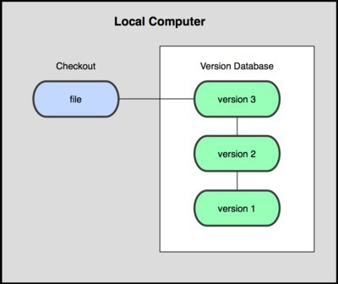
Local Version Control
Organize different versions as folders on the local machine
No server involved
Other users should copy it via disk/network

Slide 7
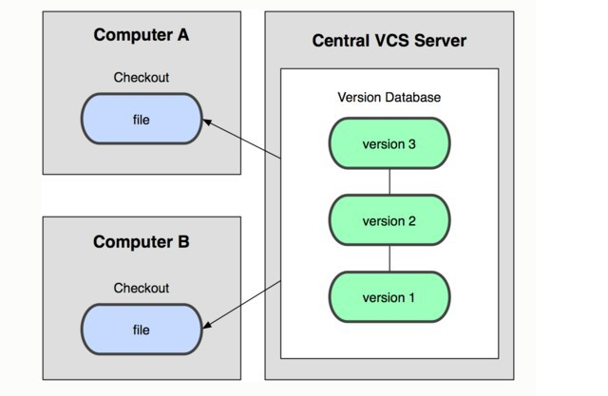
Centralized Version Control
Version history sits on a central server or cloud
Users will get a working copy of the files
Changes have to be committed to the server
All authorized users can get the changes

Slide 8
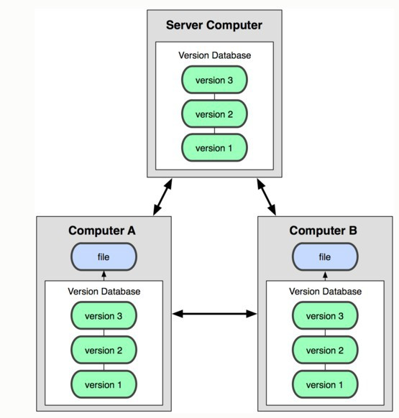
Distributed Version Control
Version history is replicated at every user's machine
Users have version control all the time
Changes can be communicated between users
Git is distributed

Slide 9
Terminologies in Version Control System
Repository
Contains files and folders related to the software code
Record full history of the project
Working copy
Copy of project’s files in a repository
Check out
The operation to create a working copy of a repository
Commit
Write the changes made in the working copy to the repository
Commits are recorded by the version control system

Slide 10
Git

Slide 11
Git
A free and open source distributed version control system
Designed to handle everything from small to very large projects with speed and efficiency
Used by almost all the famous software projects and companies

Slide 12
Git Repo Objects
Objects used by GIT
Blobs: Sequence of bytes
Trees: A group of blobs or trees
Commit: A particular “git commit” which contains all info about the commit
Tags: A name for a commit object for convenience
Objects are uniquely identified with hashes

Slide 13

Local Operations
Get working copy from a repo
Make changes
Commit local changes to a repo

Slide 14
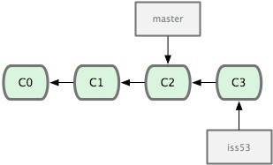
Terminologies in Git
Head
Refers to a commit object
There can be more than one heads in a repo
HEAD
Refers to the current active head
Branch
Refers to a head and its entire set of ancestor commits
Master Branch
Default branch
Detached HEAD
If a commit is not pointed to by a branch

Slide 15
Initialize a Git Repo and Add the First Commit
git init
Creates an empty git repo
Creates a .git sub directory in the current dir and contains all the information of the this repo
git add .
Stage your changes
A must before a commit
git commit
Commit your staged changes to the repo and create a git commit
Commit message to let yourself/others to know the purpose and other information of your change

Slide 16
Get Repo From an Existing Repo
Obtain a repo from a web-based hosting service, e.g., GitHub.
git clone
Create a copy of an existing repository

Slide 17
Be Aware of Your Local Changes
git status
Show your modified files
Whether your changes have been staged or not
git diff
Show changes we made compared to the current commit and staged files
git diff HEAD
Show changes we made compared to the HEAD commit

Slide 18
Controlling Version with Branch and Tags
git checkout
Jump to the specified commit or branch or tag
Can also be used to reset the changes
git branch, git checkout -b
Create a new branch on the current commit or specified commit
git tag
Create a tag to the current commit

Slide 19
Integrating Changes
Needed when you want to integrate the changes from multiple branches
Two main ways
Merge
simple and straightforward
merge two branches into one
Rebase (recommended)
much cleaner
apply one branch’s changes onto the other branch
Some other ways, e.g., cherry-pick

Slide 20
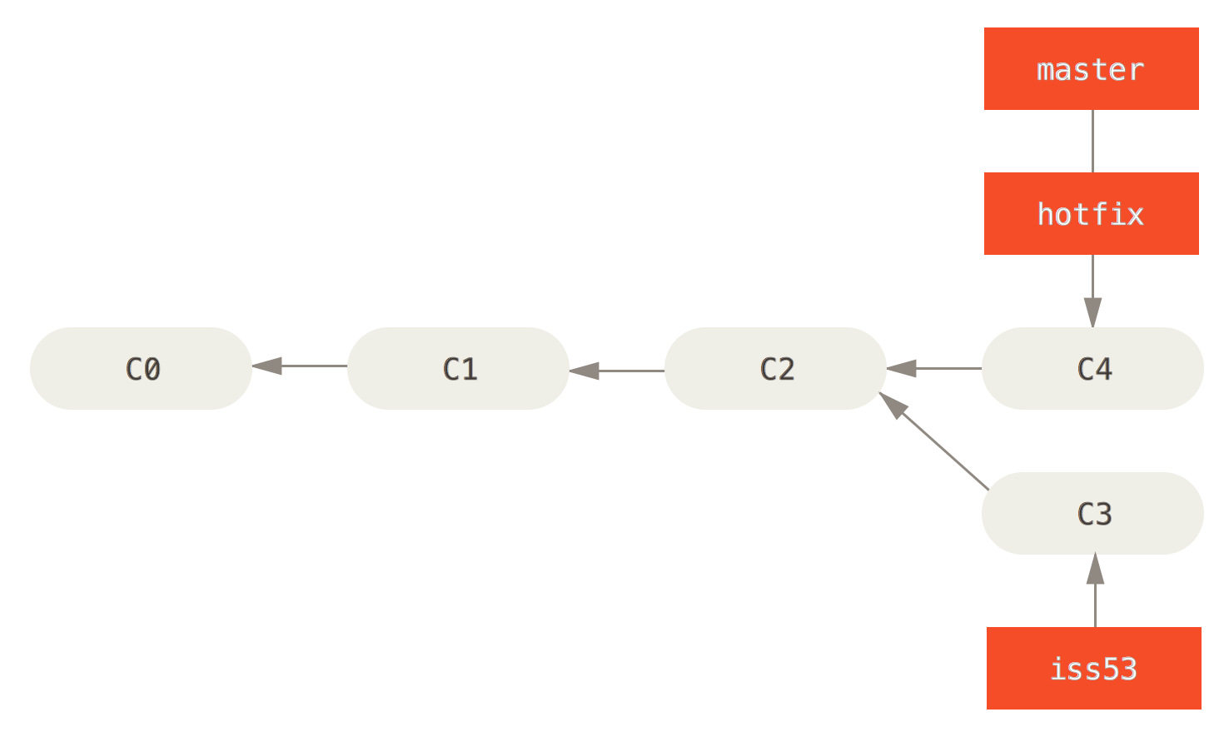
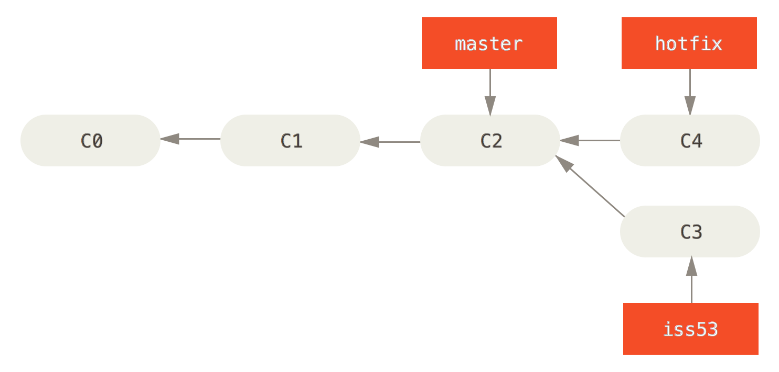
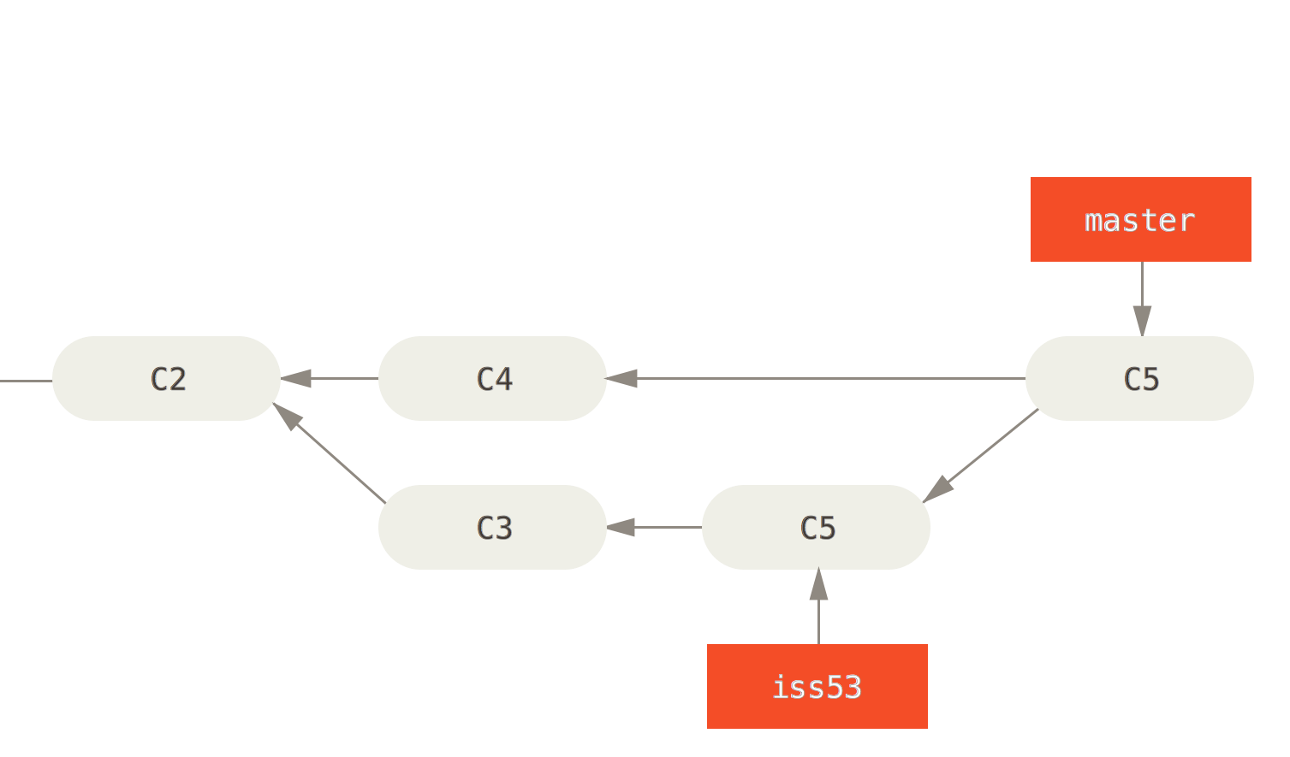
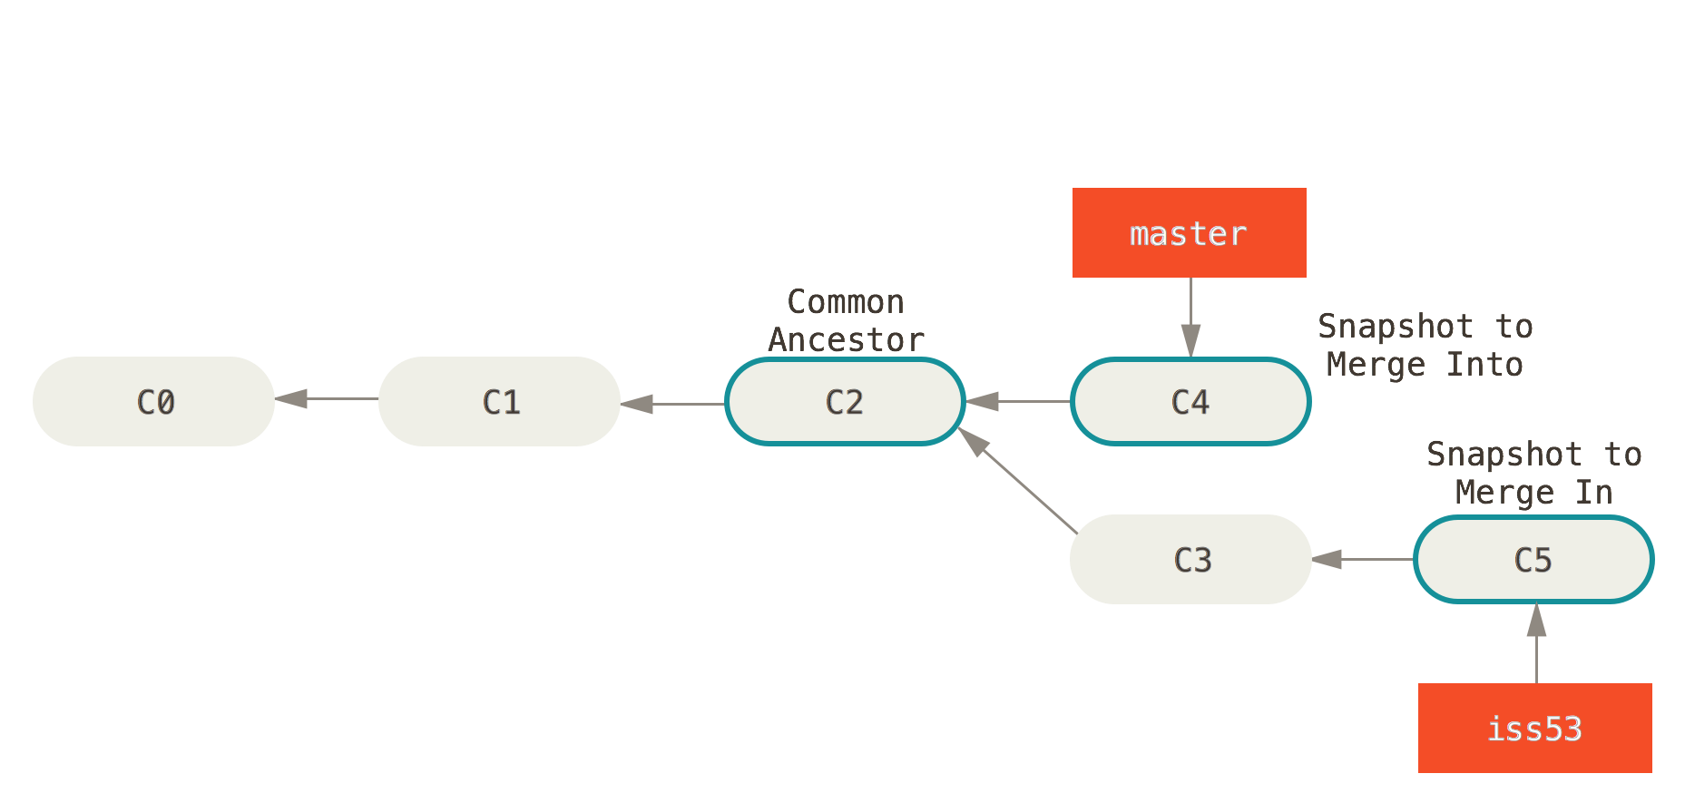
Merge in Git
1
2
3
4

Slide 21
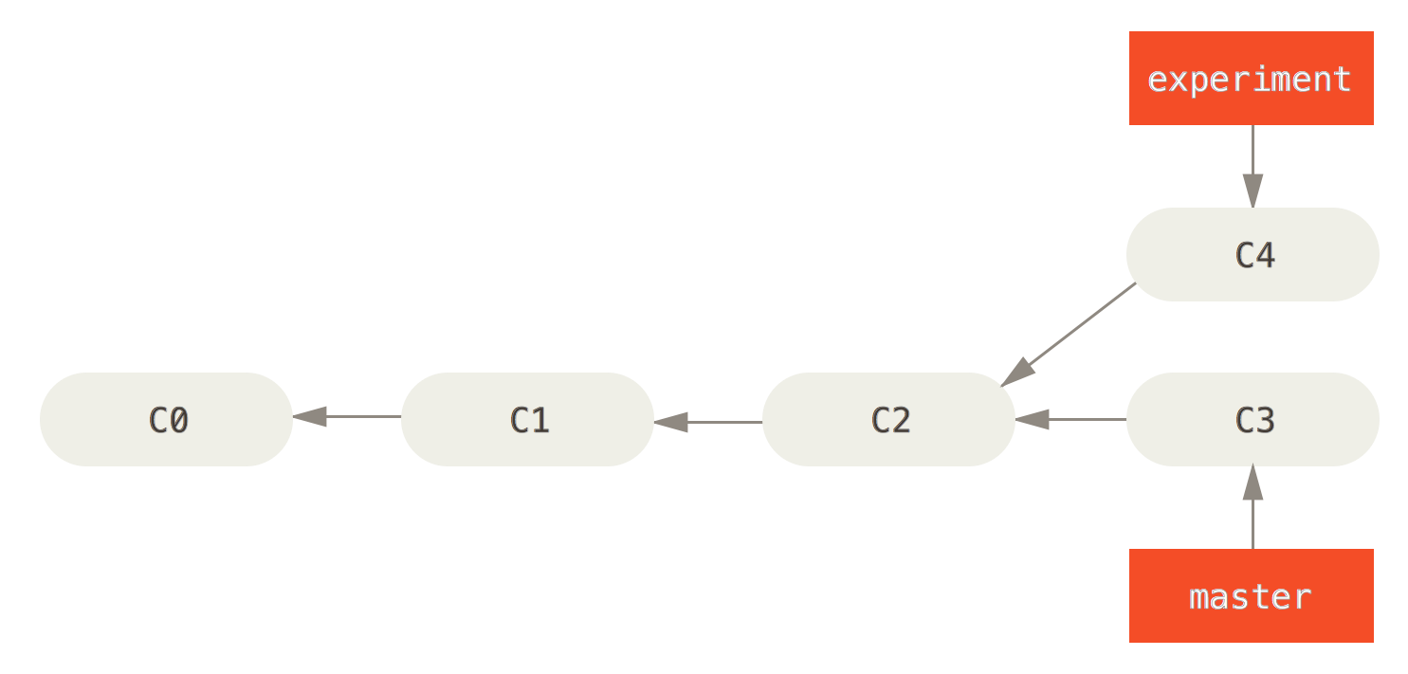
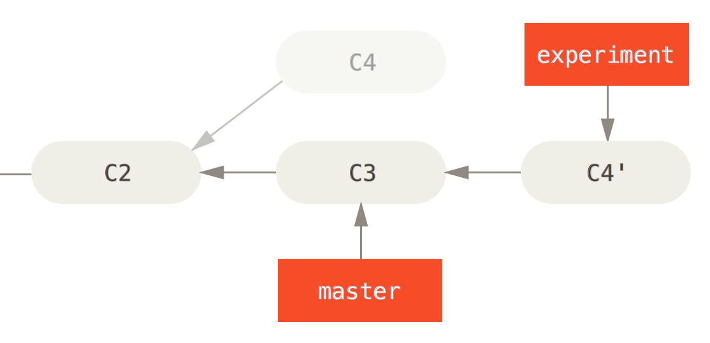
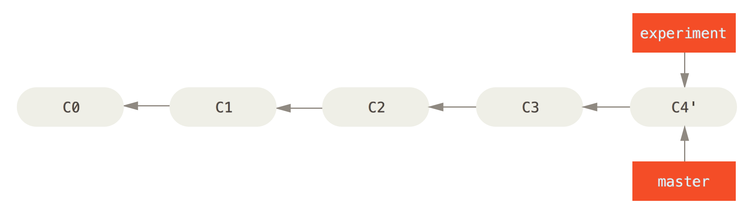
Rebase in Git
1
2
3

Slide 22
Rebase and Merge
git rebase
Rebase the current branch onto a specified commit or branch
git merge
Merge a specified commit or branch into the current branch
There will be conflicts when there are multiple commits/branches that changed the same piece of blob
Addressing the conflicts before you can finish the rebase or merge

Slide 23
Helpful Learning Material
Highly recommended tutorial: https://learngitbranching.js.org/
I learned git’s branching operations here when I was an undergraduate ☺

